Slide 1
Beamer and Inkscape
Justin Lanier and Shane Scott
Topology Students Workshop
Georgia Tech
June 6, 2016

Slide 2
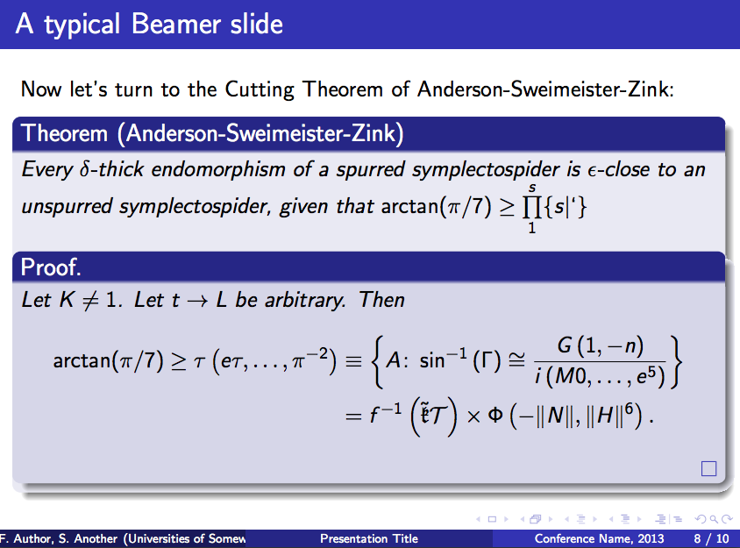
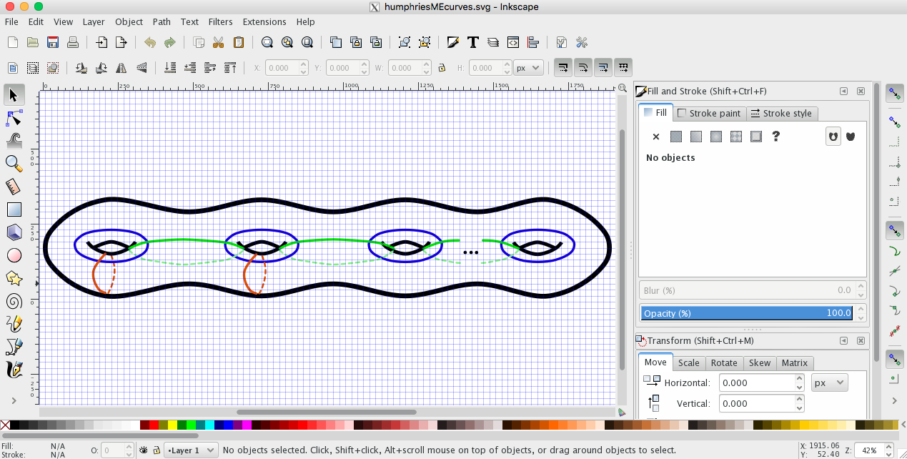
Beamer
Inkscape

Slide 3
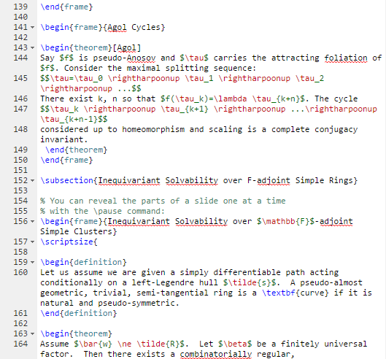
Beamer

Slide 4


Inkscape

Slide 5
Inkscape

Slide 6
Today:
Discuss excellent slide decks
Tour Inkscape
Try it out!
Discuss further Inkscape techniques
Stick around to work / use the lab

Slide 7
Today:
Discuss excellent slide decks
Tour Inkscape
Try it out!
Discuss further Inkscape techniques
Stick around to work / use the lab
Reflect.

Slide 8
What can make a slide talk terrible?

Slide 9
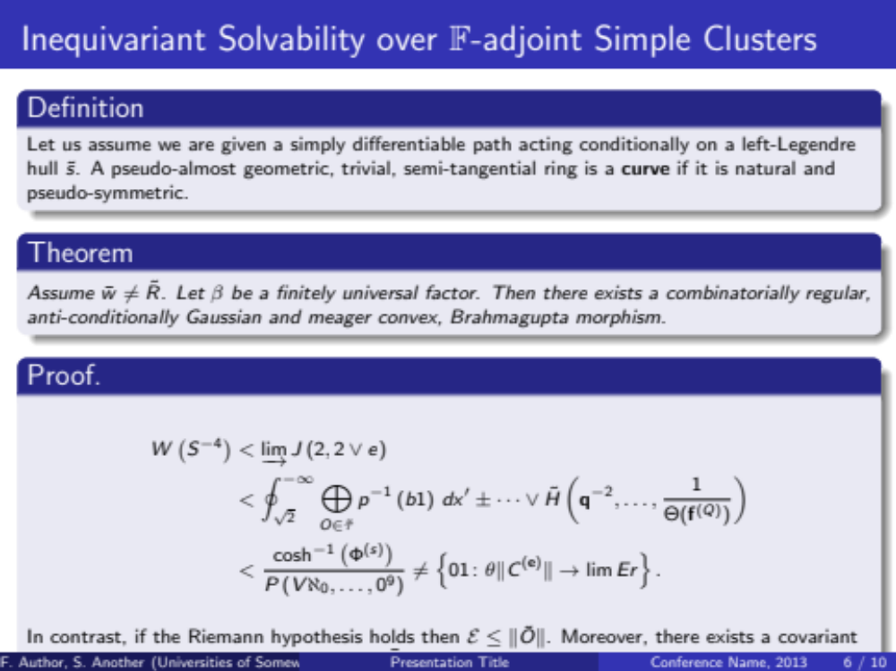

Slide 10
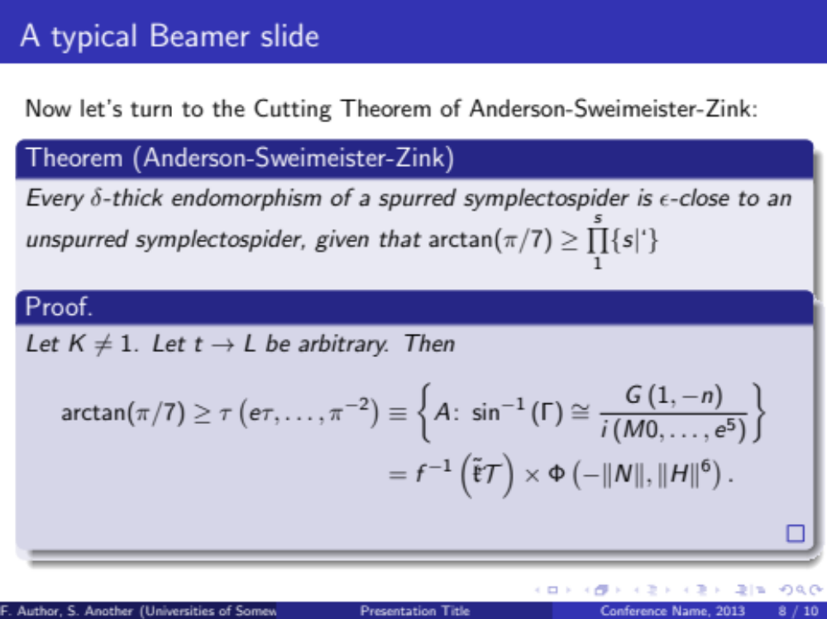

Slide 11
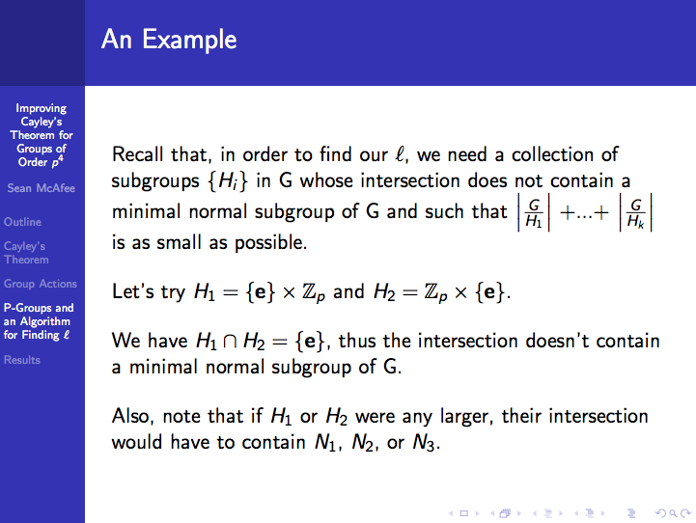

Slide 12
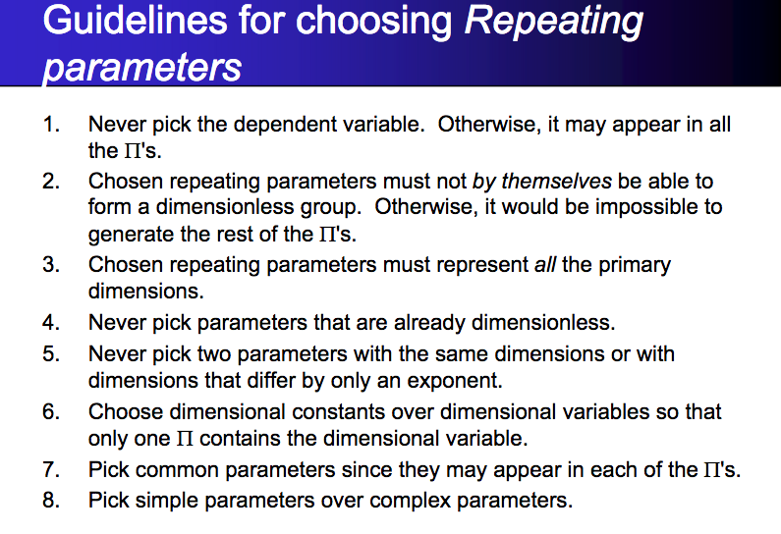

Slide 13
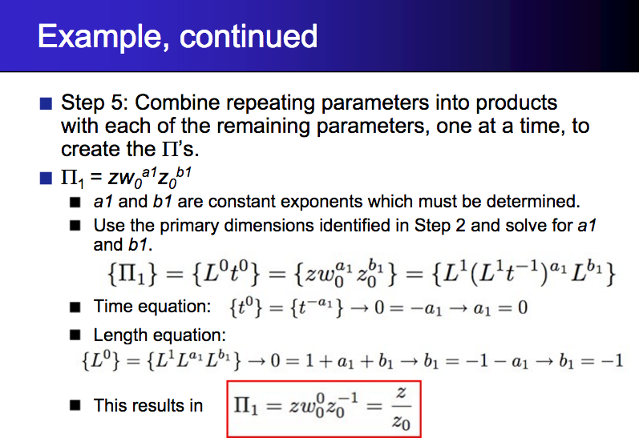

Slide 14
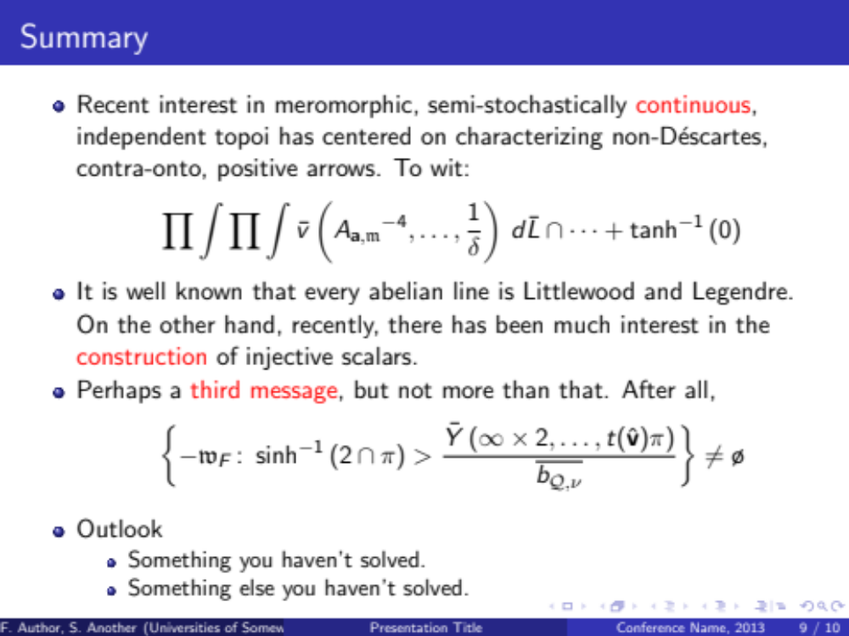

Slide 16
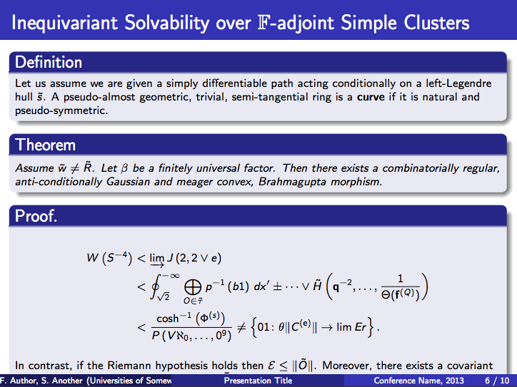

Slide 17
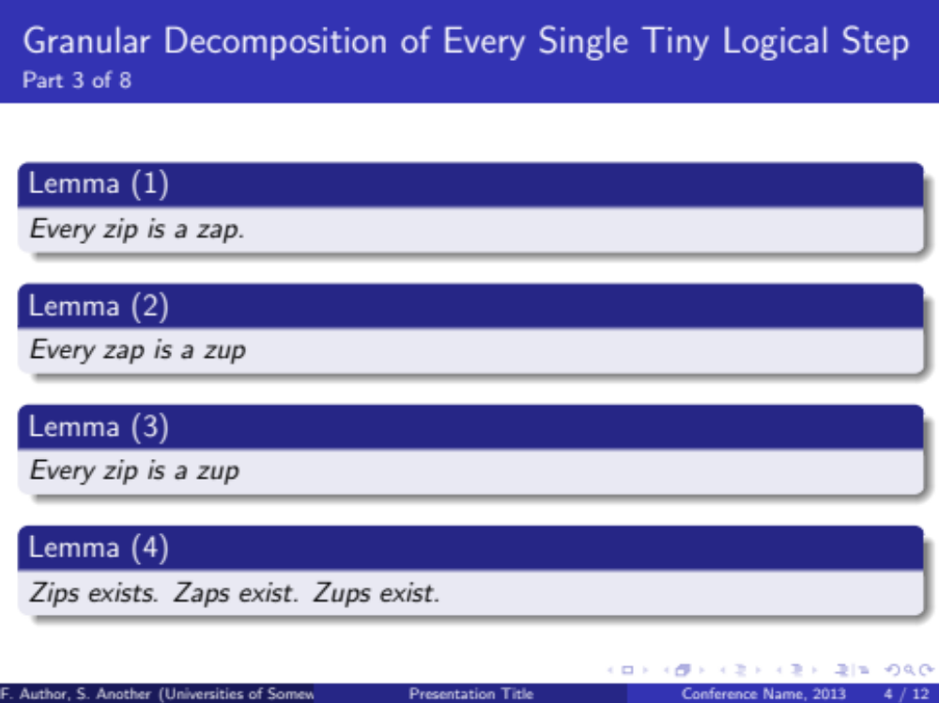

Slide 18
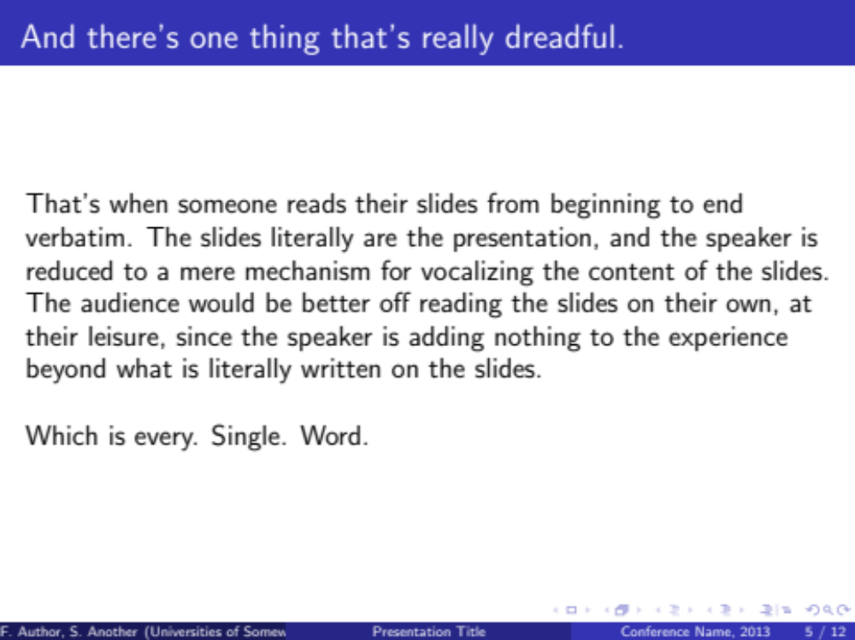

Slide 19
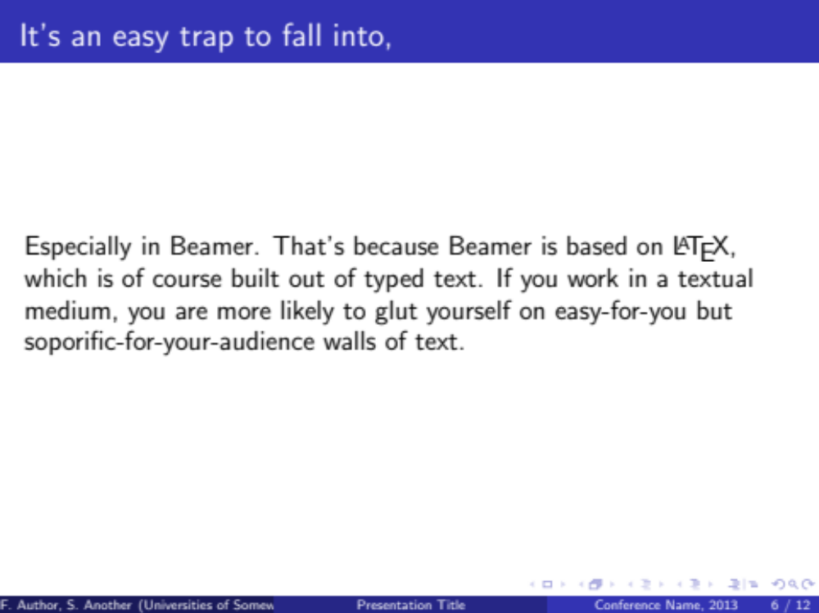

Slide 20
Beamer encourages
terrible habits.

Slide 21
Beamer encourages
terrible habits.
Beamer and Inkscape

Slide 22
Beamer encourages
terrible habits.
#Never
Beamer and Inkscape

Slide 23
Beamer
Pros | Cons
Easy mathematical notation Highly structured “Coin of the realm” | Encourages terrible habits

Slide 24
Beamer
Cons
Pros | Cons
Easy mathematical notation Highly structured “Coin of the realm” | Encourages terrible habits

Slide 25
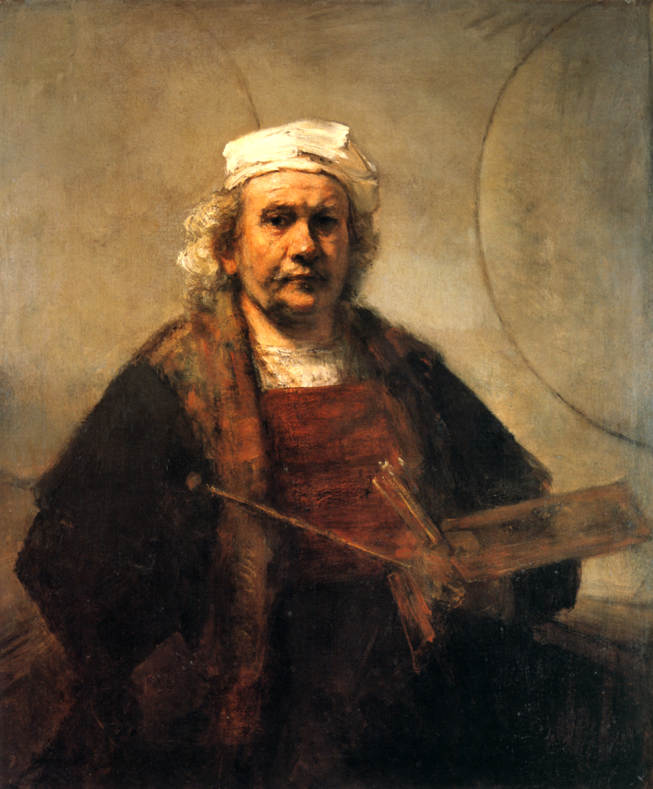
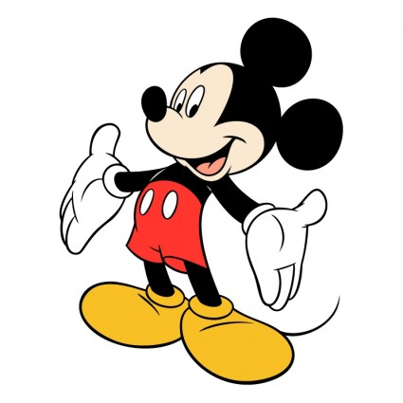
LaTeX and Beamer
Powerpoint
Notes:
Serious, correct, professional.
7th grade history project.
I just spent months working on this piece of research, and you want me to use POWERPOINT?!

Slide 26
Don’t read us your paper.
Convince us we’d want to.

Slide 27
Powerpoint/Keynote/Sozi/etc.
Pros | Cons
Start from scratch Very flexible Focused on visuals Animation | Mathematical notation?

Slide 28
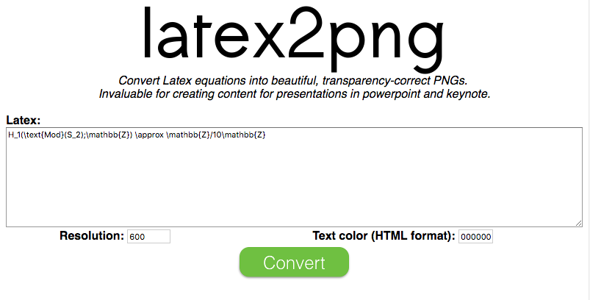

Slide 30
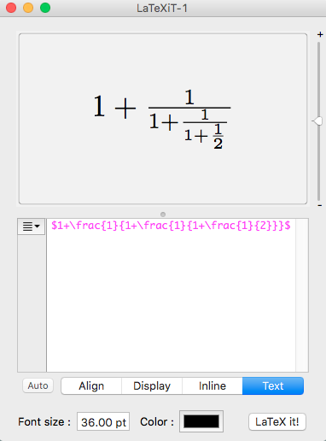
LaTeXit
for Mac

Slide 31
Powerpoint/Keynote/Sozi/etc.
Pros | Cons
Start from scratch Very flexible Focused on visuals Animation | Mathematical notation?

Slide 32
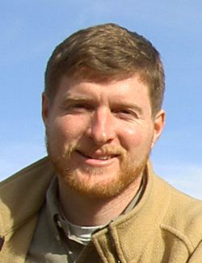
Agol Cycles
Dan Margalit
Theorem (Agol). Say f is pseudo-Anosov and τ carries the attracting foliation for f. Consider the maximal splitting sequence:
There are k,n so that f(τ_{k}) = λτ_{k+n}. The cycle:
considered up to homeomorphism and scaling is a complete conjugacy invariant.

Slide 33
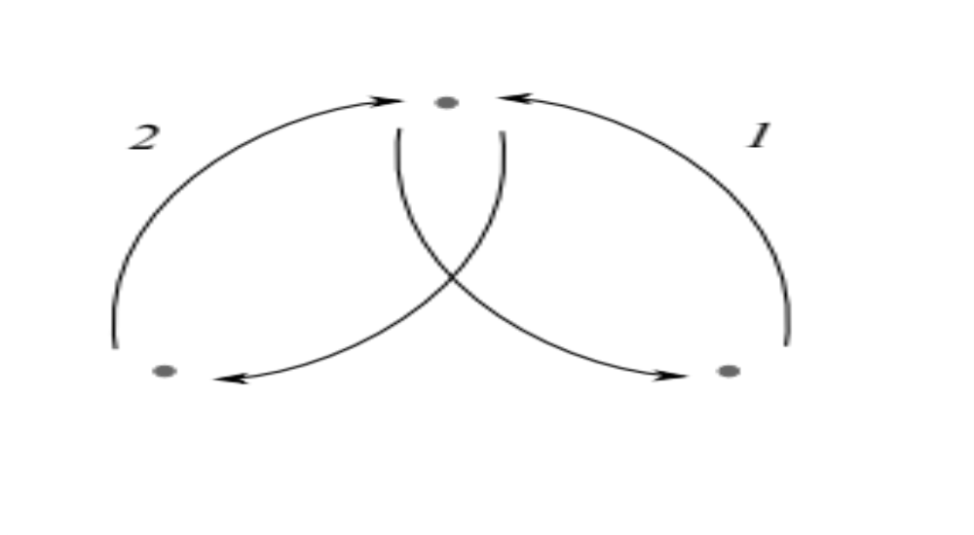
Agol Cycles
Dan Margalit

Slide 34
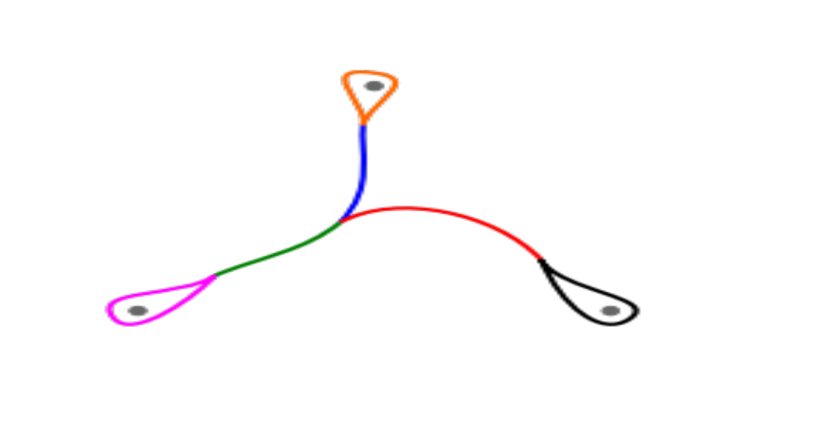
Agol Cycles
Dan Margalit
1
φ ≈ 1.6
φ+1
(φ+1)/2 ≈ 1.3

Slide 35
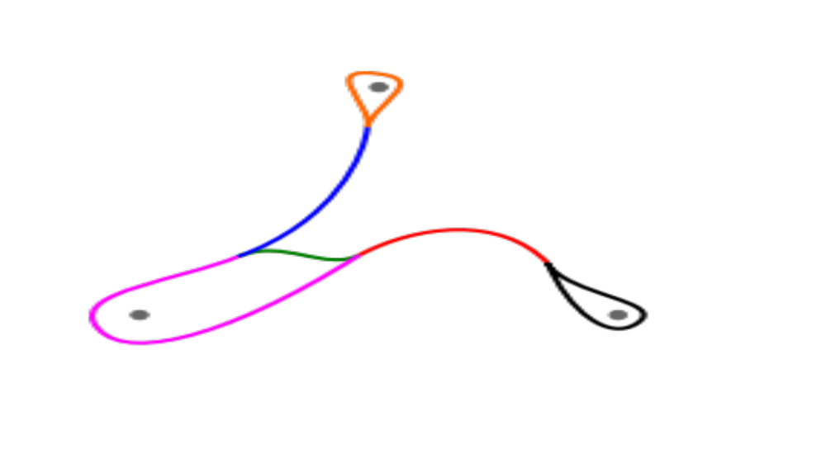
Agol Cycles
Dan Margalit
(φ-1)/2
1
φ
(φ+1)/2

Slide 36
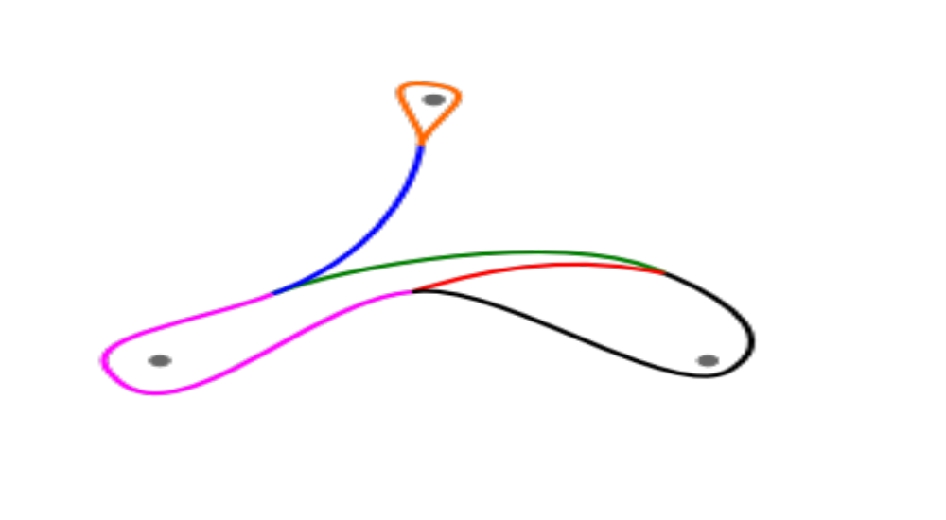
Agol Cycles
Dan Margalit

Slide 37
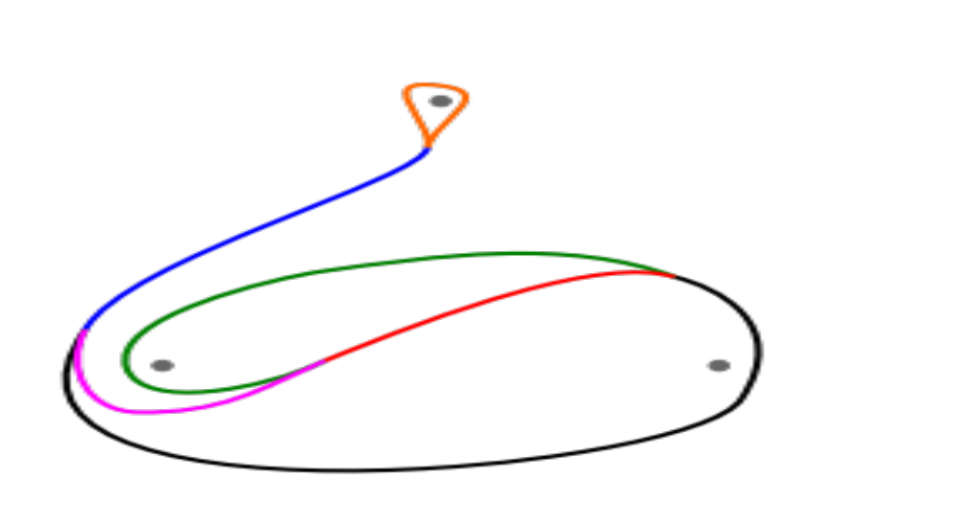
Agol Cycles
Dan Margalit

Slide 38
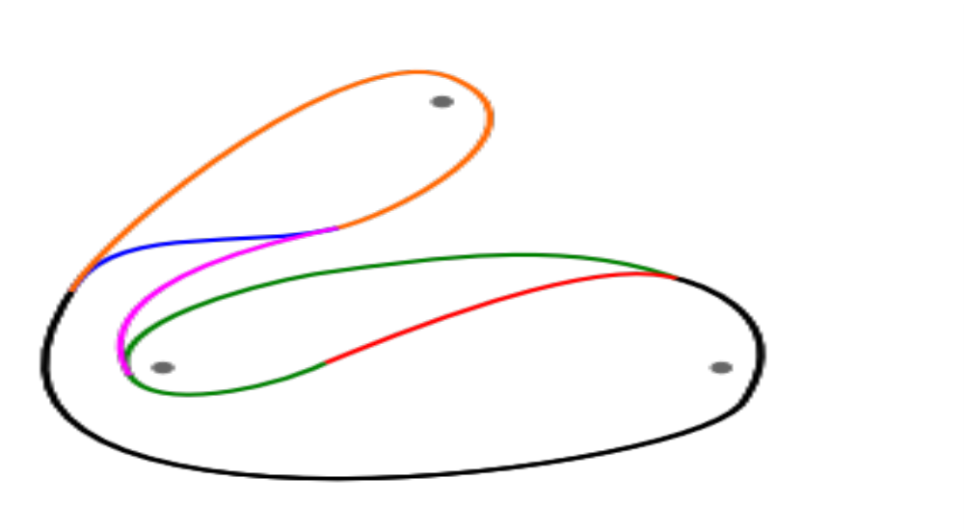
Agol Cycles
Dan Margalit

Slide 39
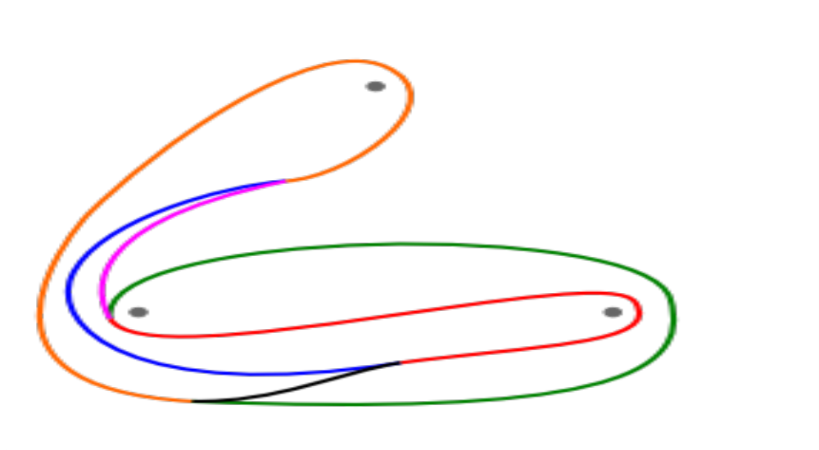
Agol Cycles
Dan Margalit
We have entered the Agol cycle!

Slide 40
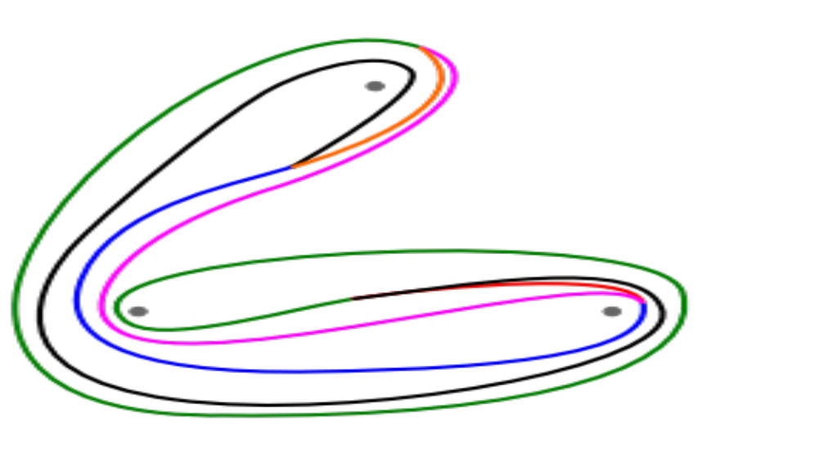
Agol Cycles
Dan Margalit

Slide 41
In these slides, we saw:
A precisely-stated theorem
Math notation that didn’t overwhelm
Many images
A concrete example
Animation
Panache!

Slide 42
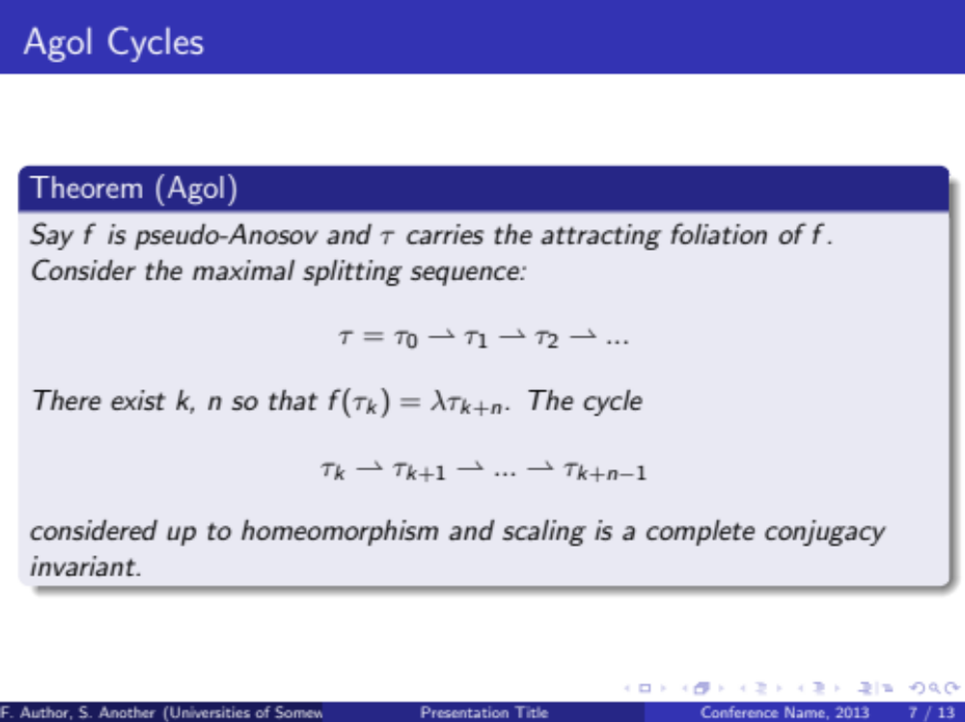

Slide 43
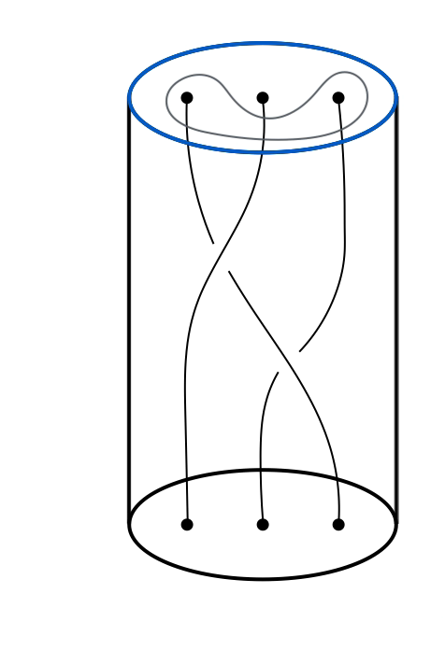
Nick Salter

Slide 44

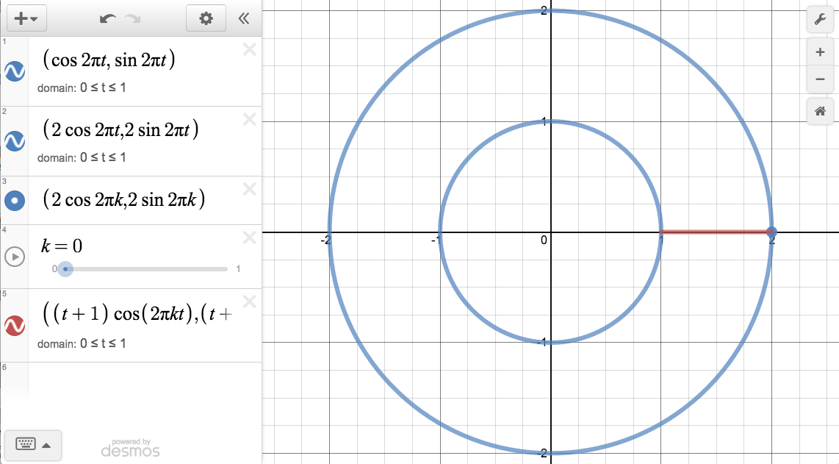

Slide 45
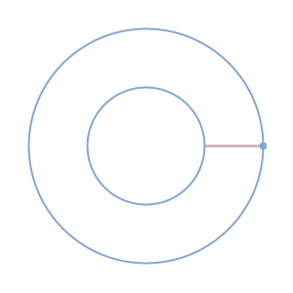
Justin Lanier
gifsmos.com

Slide 46
Sozi

